Slide 1
Credit Card Fraud Detection Capstone Project
By,
Srilakshmi K B
LIBA -Executive Post Graduate Program in BA
May 2023 batch

Slide 2
AGENDA
➢ Objective
➢ Background
➢ Key Insights
➢ Cost Benefit Analysis
➢Business Recommendations

Slide 3
Objective
Analyze the business impact of these fraudulent transactions and recommend the optimal ways that the bank can adopt to mitigate the fraud risks.

Slide 4
Background
Detecting credit card fraud using machine learning is a must in banking industry.
They need to put proactive monitoring and fraud prevention mechanisms in place.
Machine learning fraud detection algorithms are way more effective than humans.
The concept behind using machine learning for fraud detection is that fraudulent transactions have specific features that legitimate transactions.
Machine learning helps these institutions-
To reduce time-consuming manual reviews.
Costly chargeback and fees.
Denial of legitimate transactions.

Slide 5
Key Insights.
Visual Analysis for better understanding based on fraud data(1) and non fraud data(0) .
Plots will make you understand Frauds happening on the credit cards which are issued to the customers of the bank

Slide 6
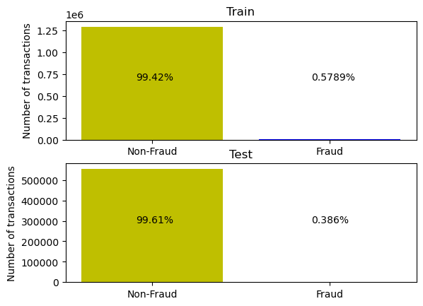
Analysis based on train data and test data

Slide 7
Current Incurred Losses
There are 77,183 credit card transactions on average every month. Among these, 402 transactions are identified as fraudulent.
The average monetary loss per fraudulent transaction is $530.66.
The cumulative expenses attributed to fraudulent transactions amount to $213,392

Slide 8
After New Model Deployment
The model identified 8,607 fraudulent transactions, resulting in a total customer support cost of $12,910.81.
Additionally, 27 fraudulent transactions went undetected by the model, resulting in a loss of $14,394.15.
The cumulative cost post-model deployment is $27,304.96.
As a result of implementing the new model, the final savings amount to $186,086.69, reflecting an impressive reduction of approximately 87% in losses

Slide 9
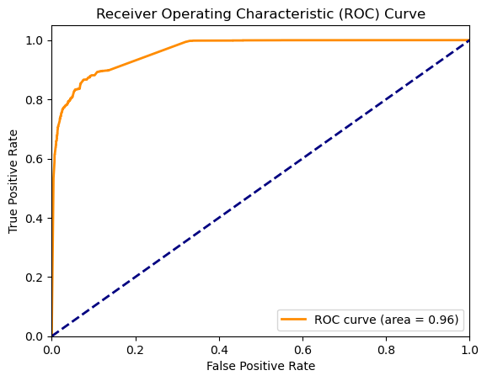
ROC Curve

Slide 10
Appendix: Data Methodology
Utilizing a Kaggle-simulated dataset, a random forest classifier was developed.
To address class imbalance, the Adaptive Synthetic (ADASYN) sampling method was employed. Due to the resource-intensive nature of Grid Search Cross Validation, manual hyper parameter tuning was conducted.

Slide 11
Business Recommendation
As per the pattern model shows that major fraud transactions are noticed in weekday Thursday, Saturday and Monday. So banks need to be extra cautious and high alert on this specific days to avoid fraudulent transactions on these categories.
The fraud transactions are majorly done during odd hours of the day i.e. between 22 - 3 Hr so banks needs to ensure to send an SMS ALERT during such odd hours.
if comparable amount spent in last 24hrs v/s past spent data gets increased then its ideal for Bank to sent an SMS ALERT! to customer confirming about the transaction.
At any point in time if bank notices the nature of amount spent is higher then regular spending pattern in such cases bank should noticed the same at early stage by sending necessary alerts to customers.

Slide 12
Thank you

